Slide 1


ASPECT RATIOS IN PROJECTION SYSTEMS
Presented by Neil Davidson

Slide 2
INTRODUCTIONS
Display Technologies Ltd was founded in 2016 by business partners Neil Davidson and Simon Ridley.
The company specialises in the development of projector screens and innovative accessories for projector systems.
Our incredible focus on the combination of technical performance and design for install ensure that Display Technologies creates solutions that meet the needs of both the client and the installer.
Display Technologies never accept second best and in our short history have already made several advances in projection screen design – particularly the incredible Dynamic series masking screens featuring Mask Position Logic, the only masking screens that are driven by aspect ratio not presets.

Slide 3
ASPECT RATIOS
Aspect Ratio describes the ratio of image width to image height
For example: 1.33:1 would indicate that the image width was 1.33x the image height
It is always easiest to compare aspect ratios when the height value is 1
For example: 16:9 is the same as 1.7778:1 ~ 1.78:1
We get content delivered in a really wide range of aspect ratios
1.33
1.78
2.35
2.76
We have so many aspect ratios due to a combination of artistic, technical and commercial factors that have been relevant over the 120 years that we have had motion pictures
Lets quickly look at some aspect ratios…

Slide 4
SOME ASPECT RATIOS
1.78
2.59
1.33

Slide 5
WHY DOES THIS MATTER
As you could see, an aspect ratio simply defines the relationship between the width and height of a given image.
Over the years dedicated projection systems to easily project these different aspects perfectly.
Over the years however some important technology changes have occurred
Projection systems have become standardised in their native aspect ratio
We have moved from film to digital as the default playback medium
This is important as we now need to find ways to optimally store digital content in various aspect ratios and we also need to adapt this for the native aspect of the projector

Slide 6
THE STORAGE FRAME
The storage frame describes the size and aspect ratio used by the playback medium
Typically described in number of pixels width x height
For Example:
Bluray = 1920 x1080 pixels
1920 / 1080 = 1.7778 aspect
UHD = 3840 x 2160 pixels
3840 / 2160 = 1.7778 aspect
4K = 4096 x 2160 pixels
4096 / 2160 = 1.896 aspect
Note that the storage frame size tends to define the native projector aspect ratio

Slide 7
THE CONTENT FRAME
The content frame describes the size and aspect ratio of the content which is to be contained within the storage frame
It is logical that this content frame should contain as many pixels as possible to maximise the resolution of the image
There are a couple of simple rules that you can use to work out the content frame size in instances where the content frame and storage frame aspect don’t match
If content frame aspect is less than storage frame aspect
fill full height of storage frame
If content frame aspect is greater than storage frame aspect
fill full width of storage frame

Slide 8
1.78 Storage Frame
1920 x 1080 pixels

Slide 9
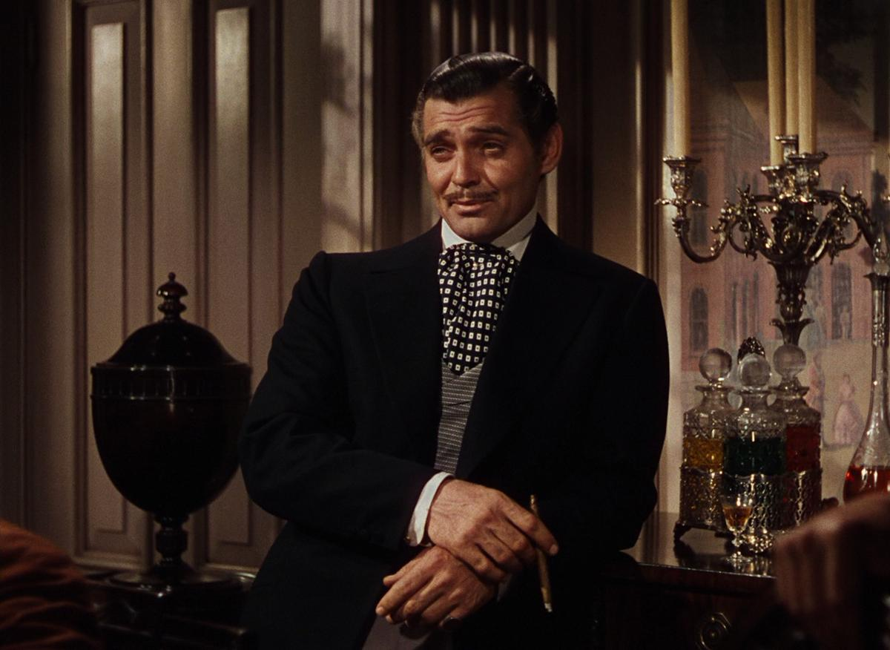
1.33 Content Frame
1404 x 1080 pixels

Slide 10
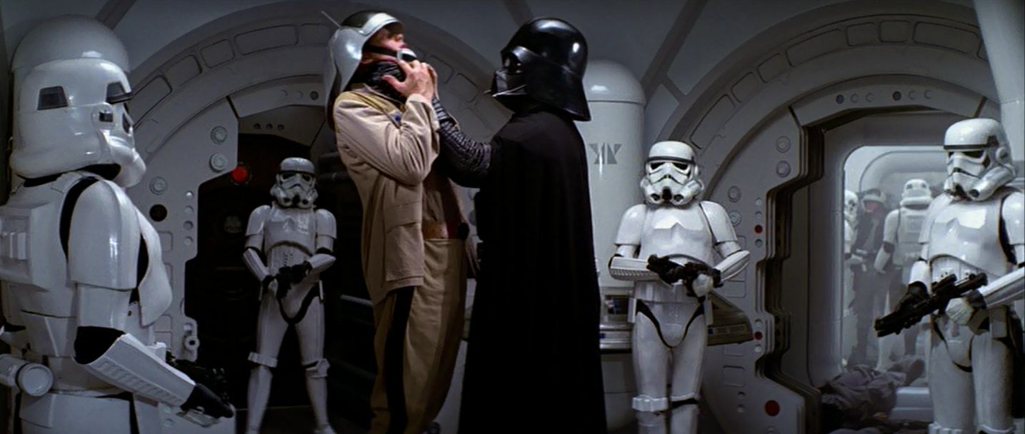
2.35 Content Frame
1920 x 817 pixels

Slide 11
PROJECTING THE CONTENT
A) Where the content frame does not match the storage frame OR
B) Where the storage frame does match the native resolution of the projector
Results in black bars being projected at the top or side of the image on screen
We know that clients tend to hate black bars being projected!
One of the best things about projection is that we can manipulate the image much more than can be achieved with a flat panel
We can alter the size or even shape of the projected image to match the content aspect ratio not the storage aspect ratio
We can adjust the size and shape of the projection screen to match the projected image

Slide 12
OPTION 1 – Anamorphic Lens
Come in two types
Horizontal Expansion – optically stretch image width by 33%
Vertical Compression – optically compress the image height by 25
Disadvantages
Expensive
Difficult to install
Severely limit installation options
Introduce unavoidable image artefacts and limit sharpness
Advantages
More light output?
Use the whole chip in the projector?
This is the technology of 10 years ago. There is no reason to specify anamorphic anymore

Slide 13
OPTION 2 – Lens Memories
Motorised Lens Memory functions are available from almost manufacturers
A preset is stored for each memory and will typically contain
Zoom
Shift
Focus
Supported aspects limited only by number of memory slots and zoom range of lens
Disadvantages
Black bars are still projected on to wall around the screen
On many projectors the change in zoom creates a large change in light output
Advantages
Easy to install
Flexible configuration

Slide 14
OPTION 3 – Native Cinemascope
Native Cinemascope projectors are available from Barco Residential
These have a resolution of
2560 x 1080 (current models)
5120 x 2160 (coming models)
Automated detection of correct aspect ratio and signalling for screen
Disadvantages
Limited to switch between 1.78 – 2.35 currently
Small price premium
Advantages
Easy to install
Extremely flexible integration
No optical artefacts, change of brightness or loss of focus

Slide 15
SCREEN MASKING
Changing image size or shape to match the content aspect causes issues
How can you change the screen size?
How can you change the screen shape?
Do you need to worry about this if you have an image on the screen?
Changing the screen size and shape is possible – masking screens!
Proper screen masking has a number of benefits
Enhanced contrast
Enhanced colour
Looks really impressive!

Slide 16
CIH CIW CIA
CIH – Constant Image Height
Image height remains the same for all aspects but width varies
Requires side masking
CIW – Constant Image Width
Image width remains the same for all aspects but height varies
Requires top and bottom masking
CIA – Constant Image Area
Image area matches for Flat and ‘Scope aspect but width and height vary
Requires 4 way masking

Slide 17
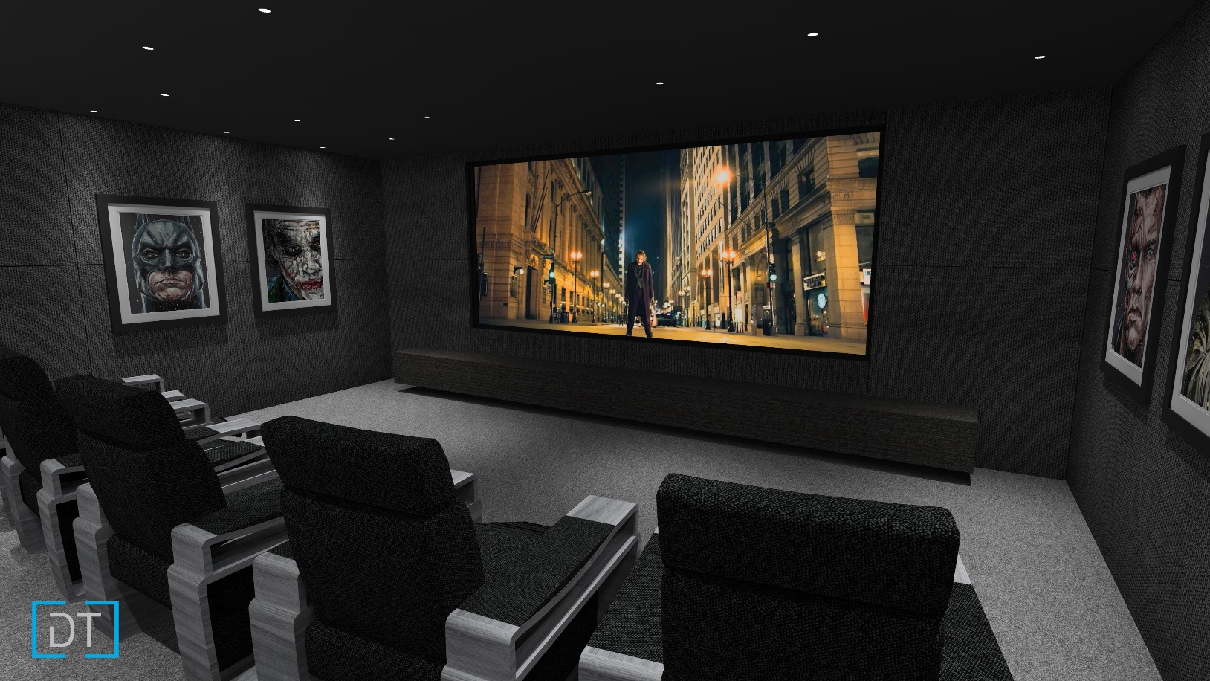

Side Masking Screen Open

Slide 18
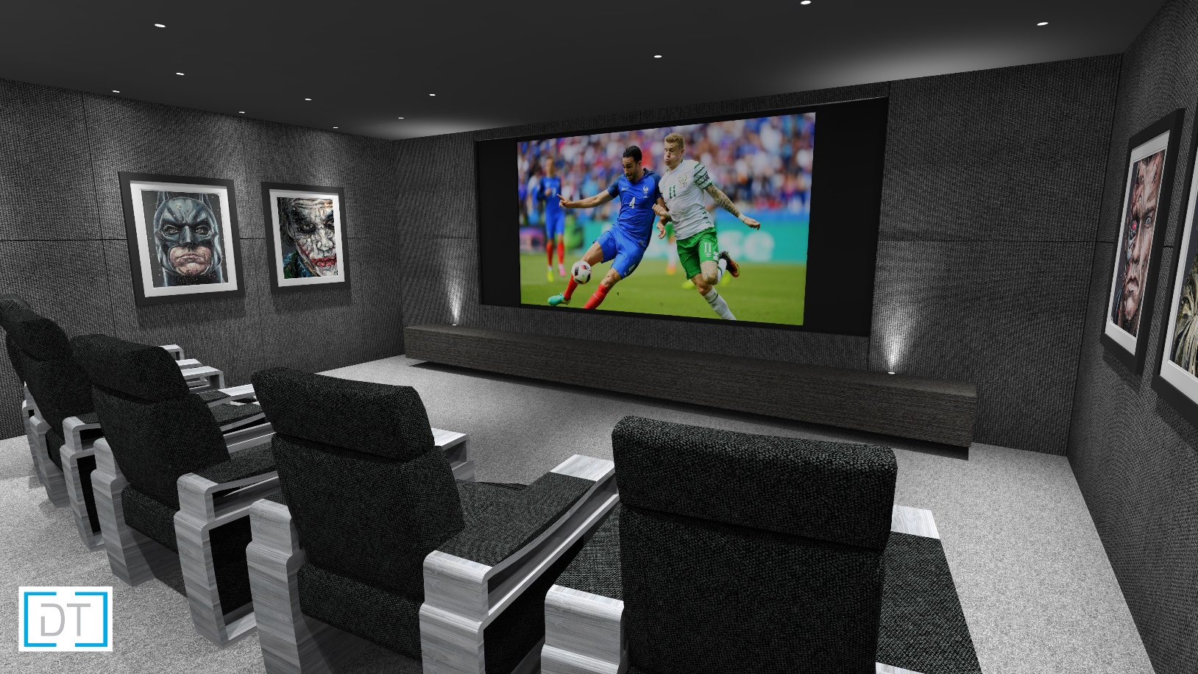
Side Masking Screen Closed

Slide 19
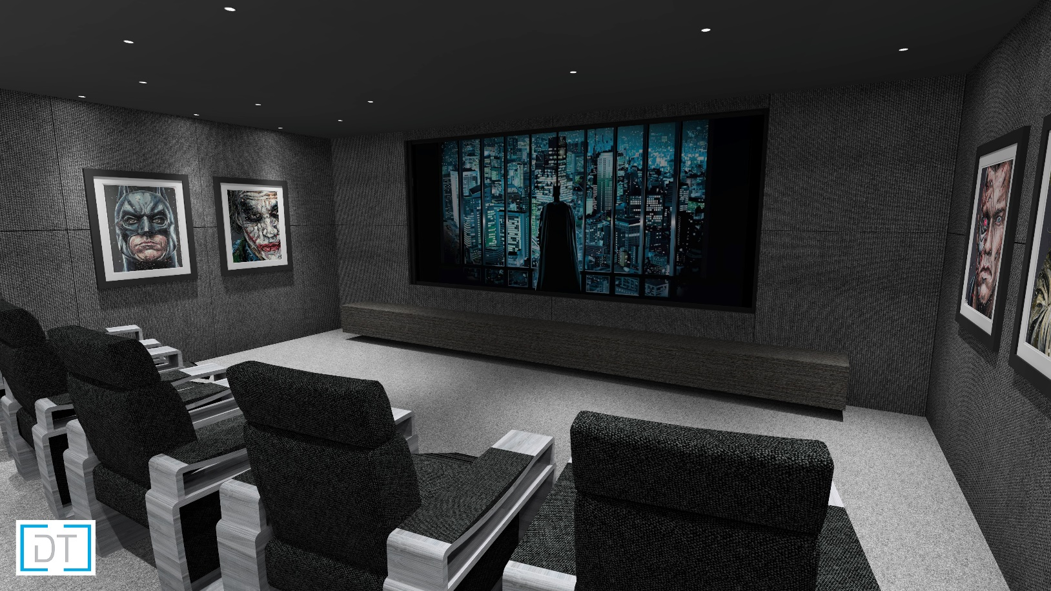
Art Mask

